Slide 1
AE 3531: Intro to your final project
Brian Kaplan & Morgan Cook

Slide 2
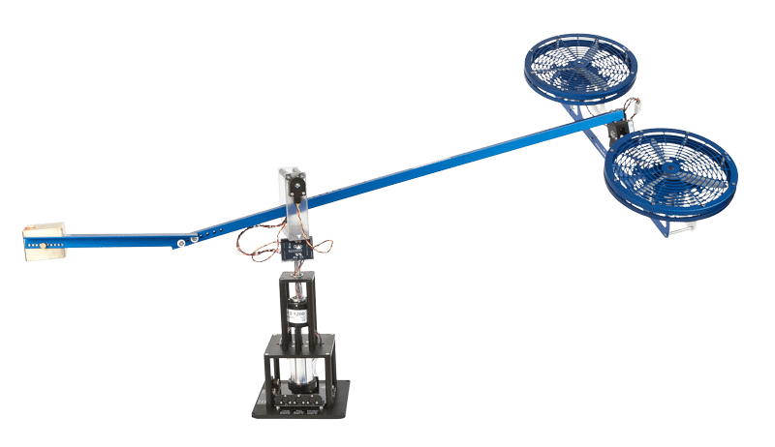
Rationale
Goal: provide a complete understanding of a very basic, yet functional controller
Disadvantages of Quanser (AE 4610)
Expensive (~$10k - $20k)
Bulky
Complex (Both Theory and Software)
Why you are doing this project:
Introduction to various types of control
Transparency of the controller
Experience with Arduino and basic electromechanical systems
Figure 1. Quanser 3-DOF helicopter
https://www.quanser.com/products/3-dof-helicopter/

Slide 3
What if...
Students could have their own personal systems?
They were simple, compact, and affordable?
They could replace your final exam?

Slide 4
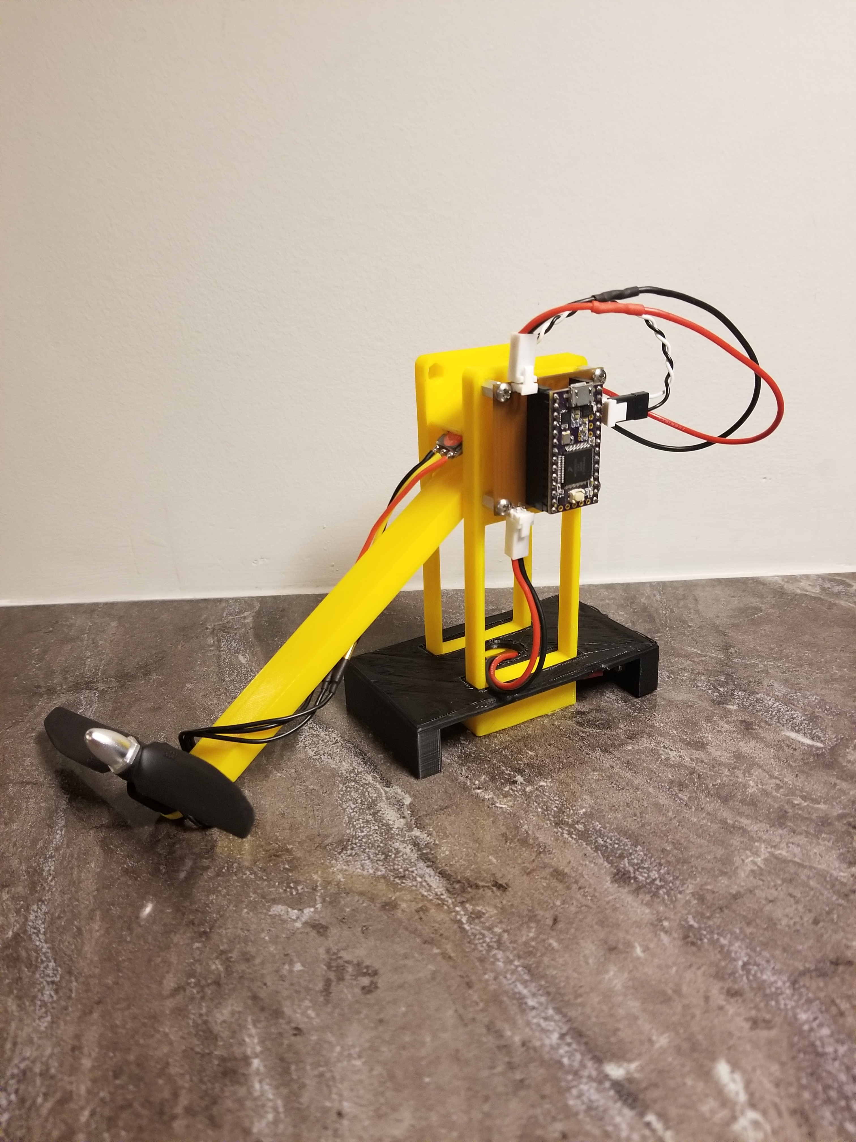
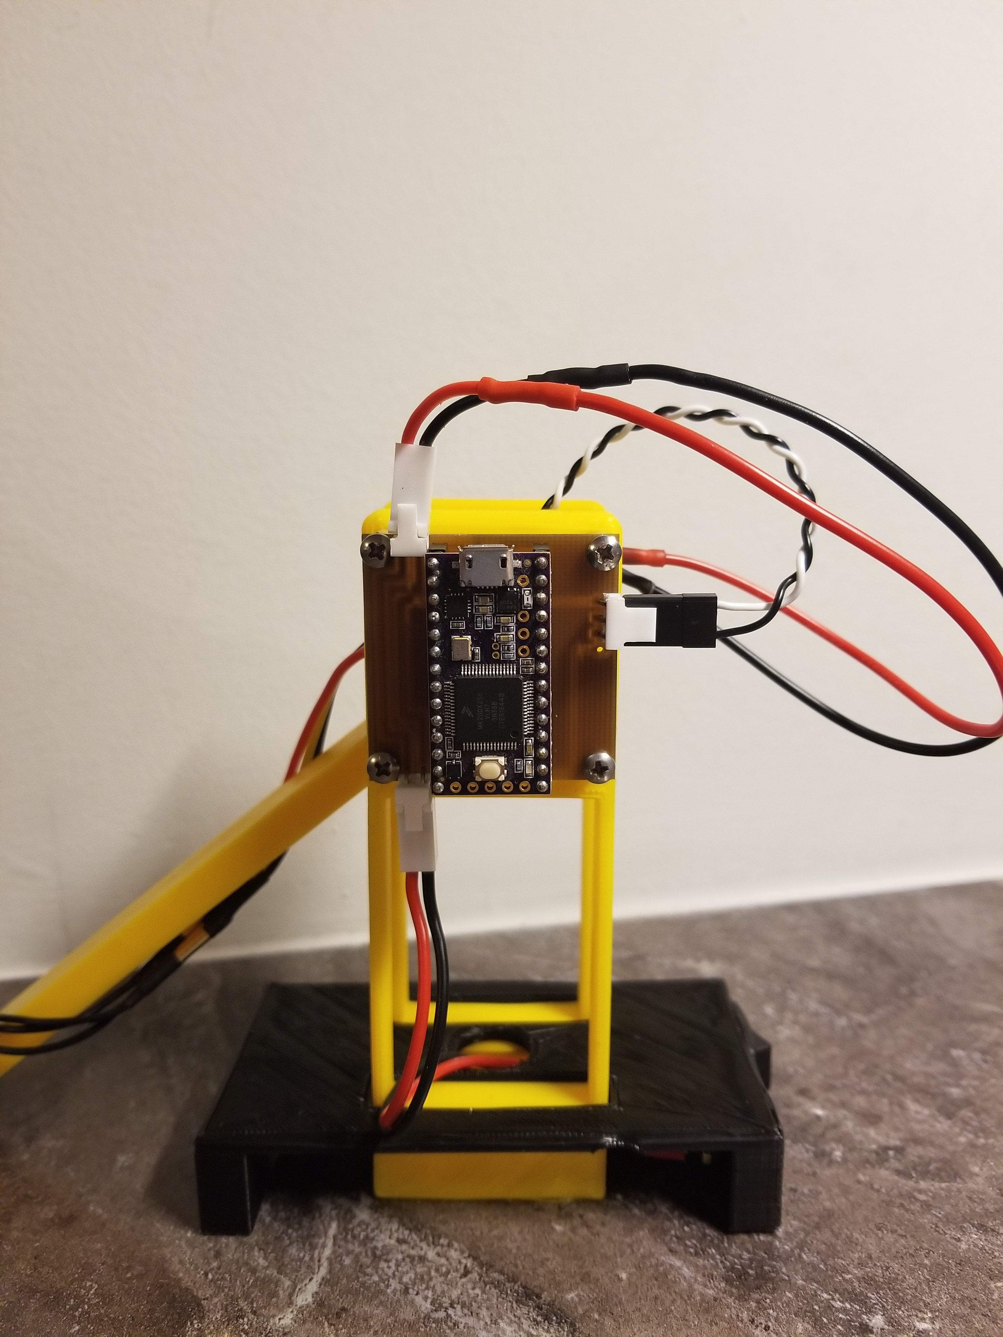
Introducing The T-RECS
Transportable
Rotorcraft
Electronic
Control
System

Slide 5
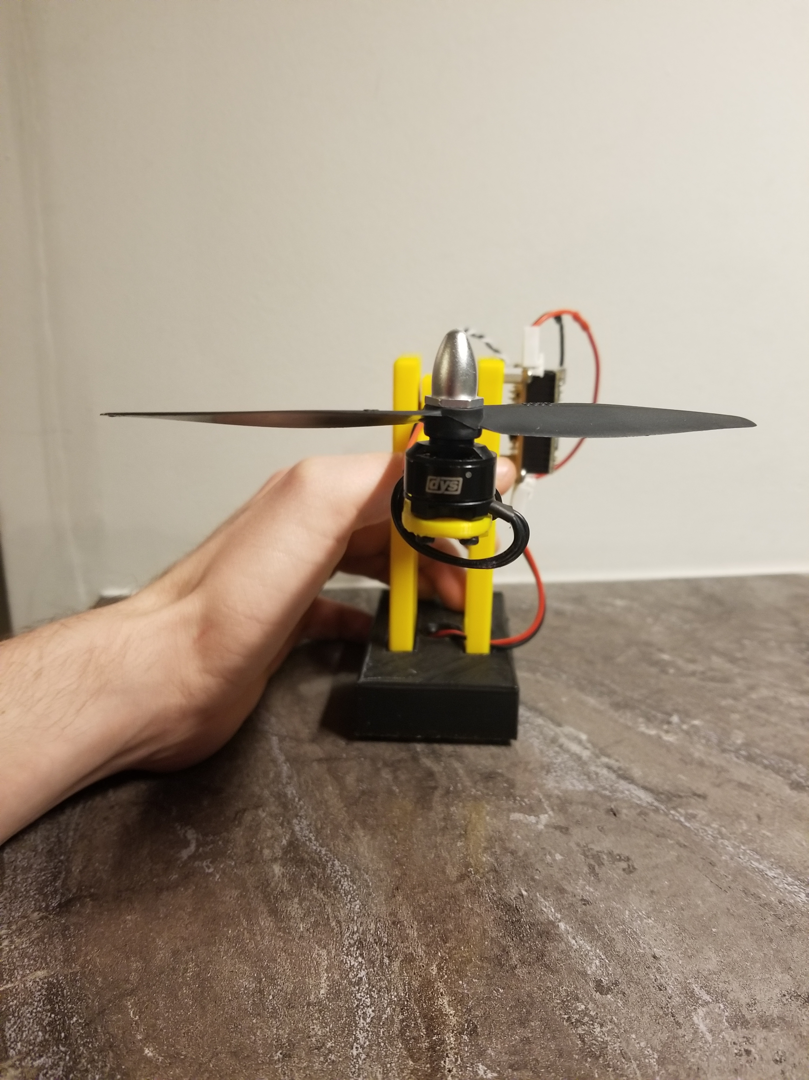
Mechanical Features
Simple 1 DOF Helicopter
Arm on Low-Friction Bearing
Simple & Easy to Model
Rotary Position Sensor
Fixed to Arm Shaft
Brushless DC Motor

Slide 6
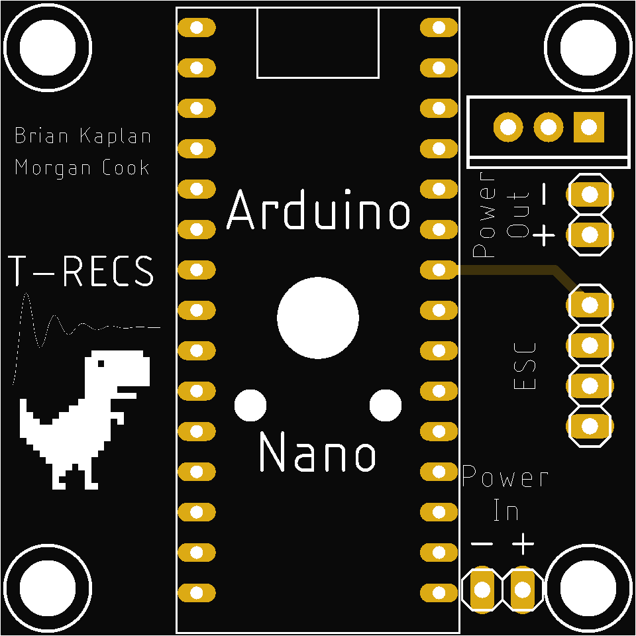
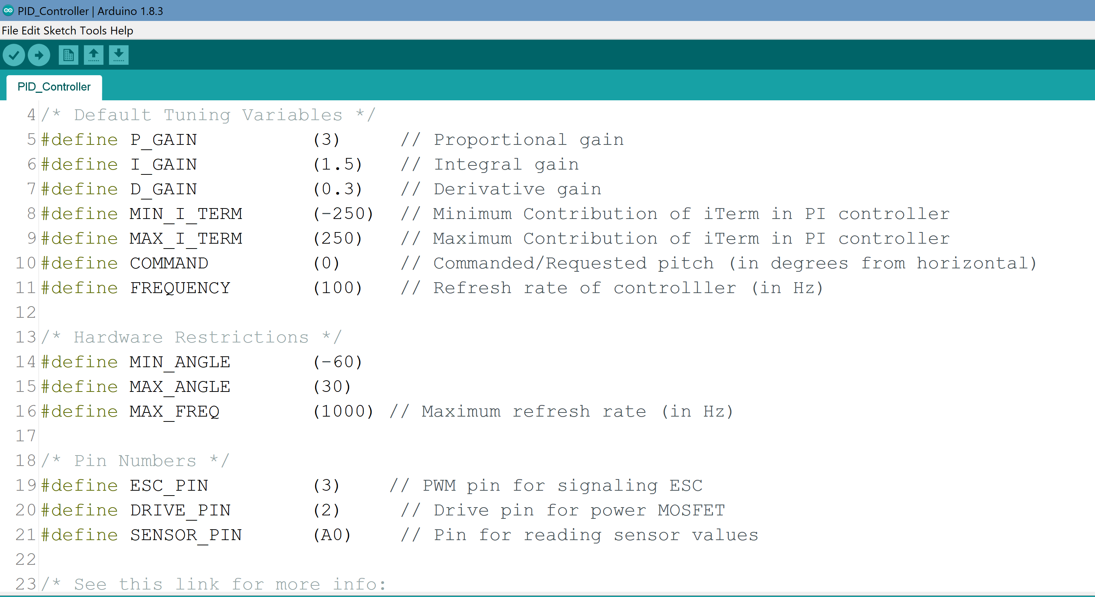
electrical Features
Electronic Speed Controller
Commonly Found in Quadcopters
Printed Circuit Board
Consolidated Electronics
Arduino Microcontroller & Software
Transparent & Easy to Follow

Slide 7
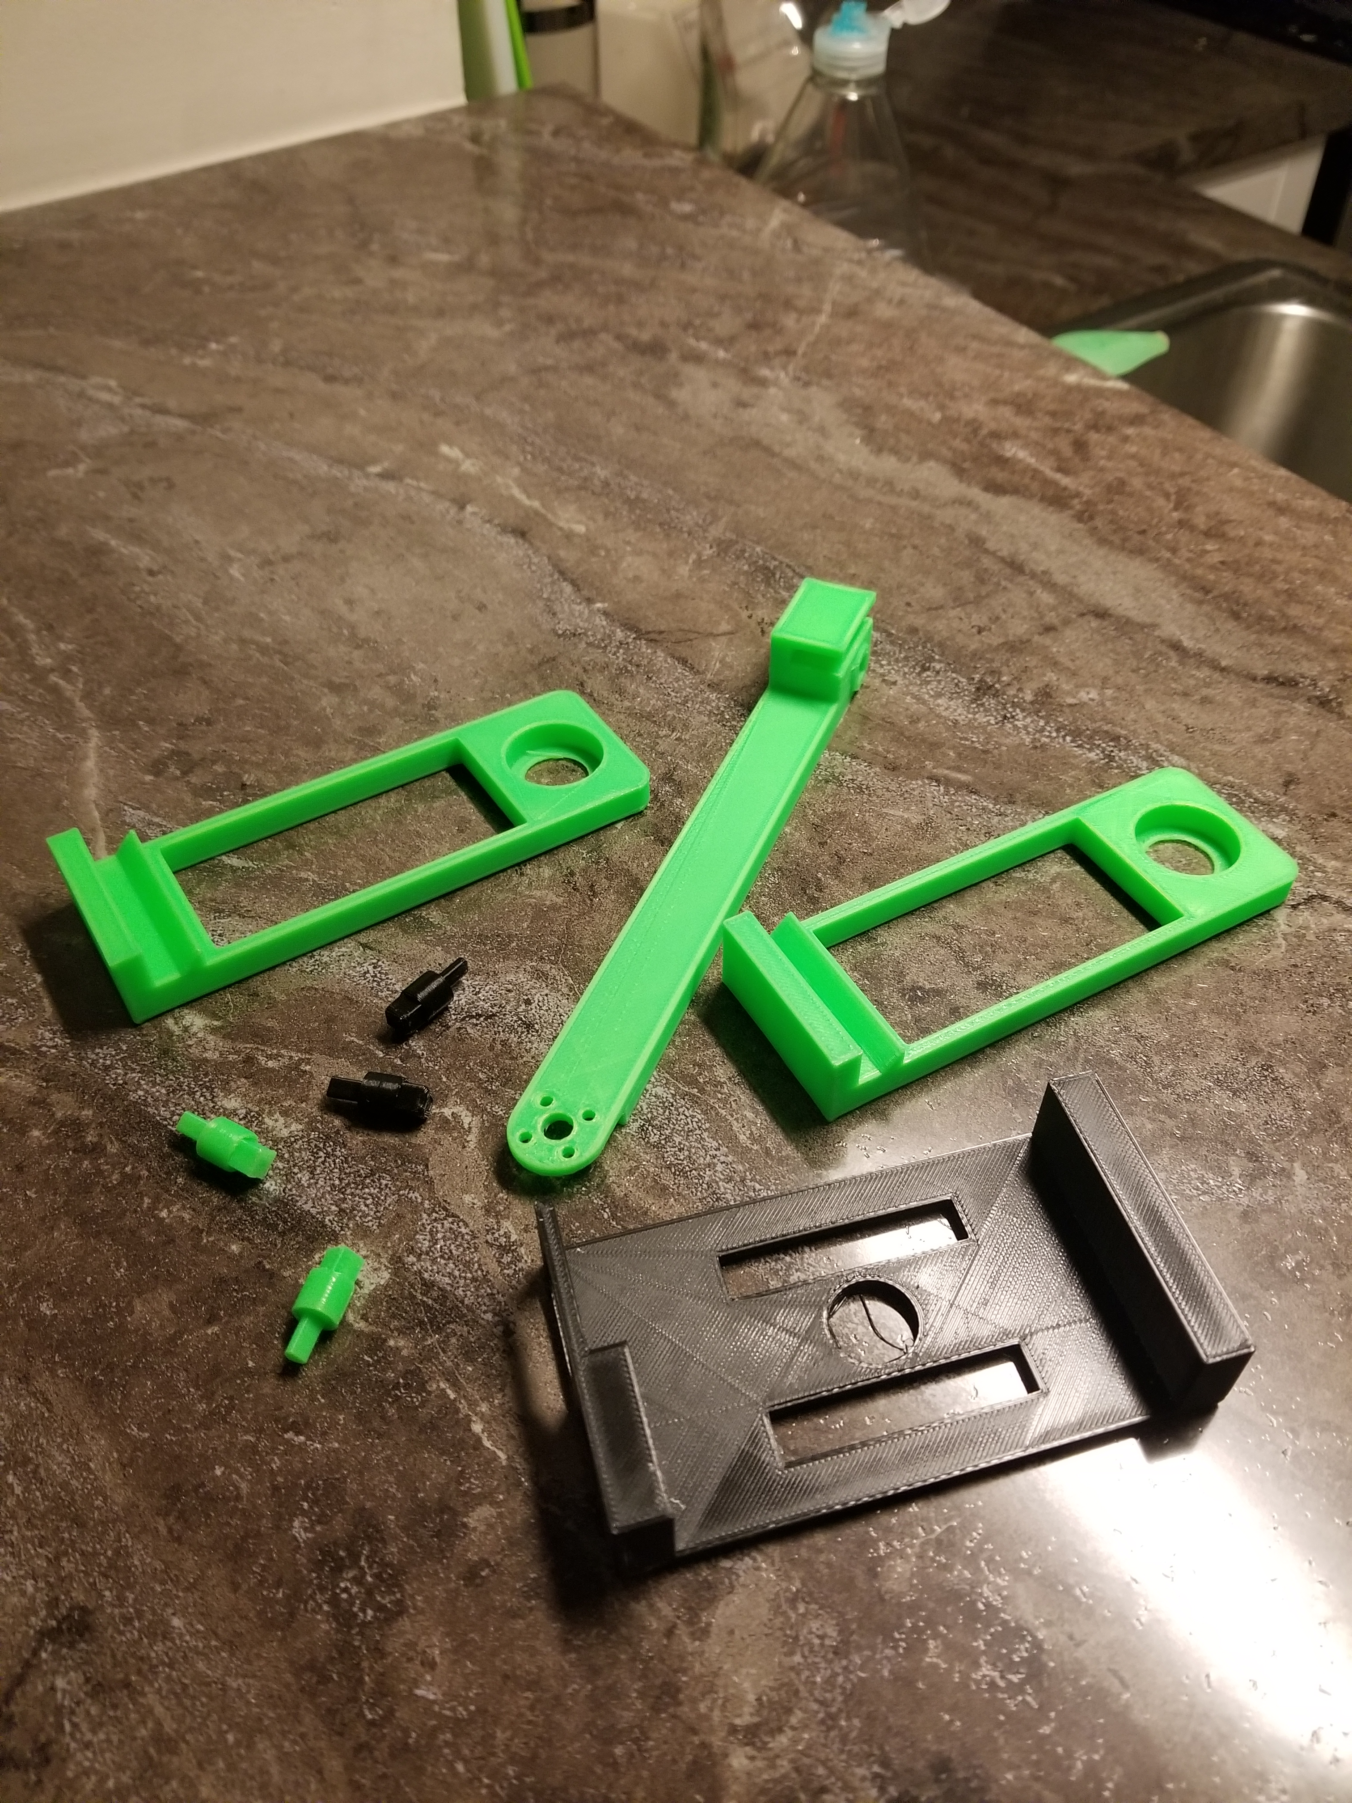
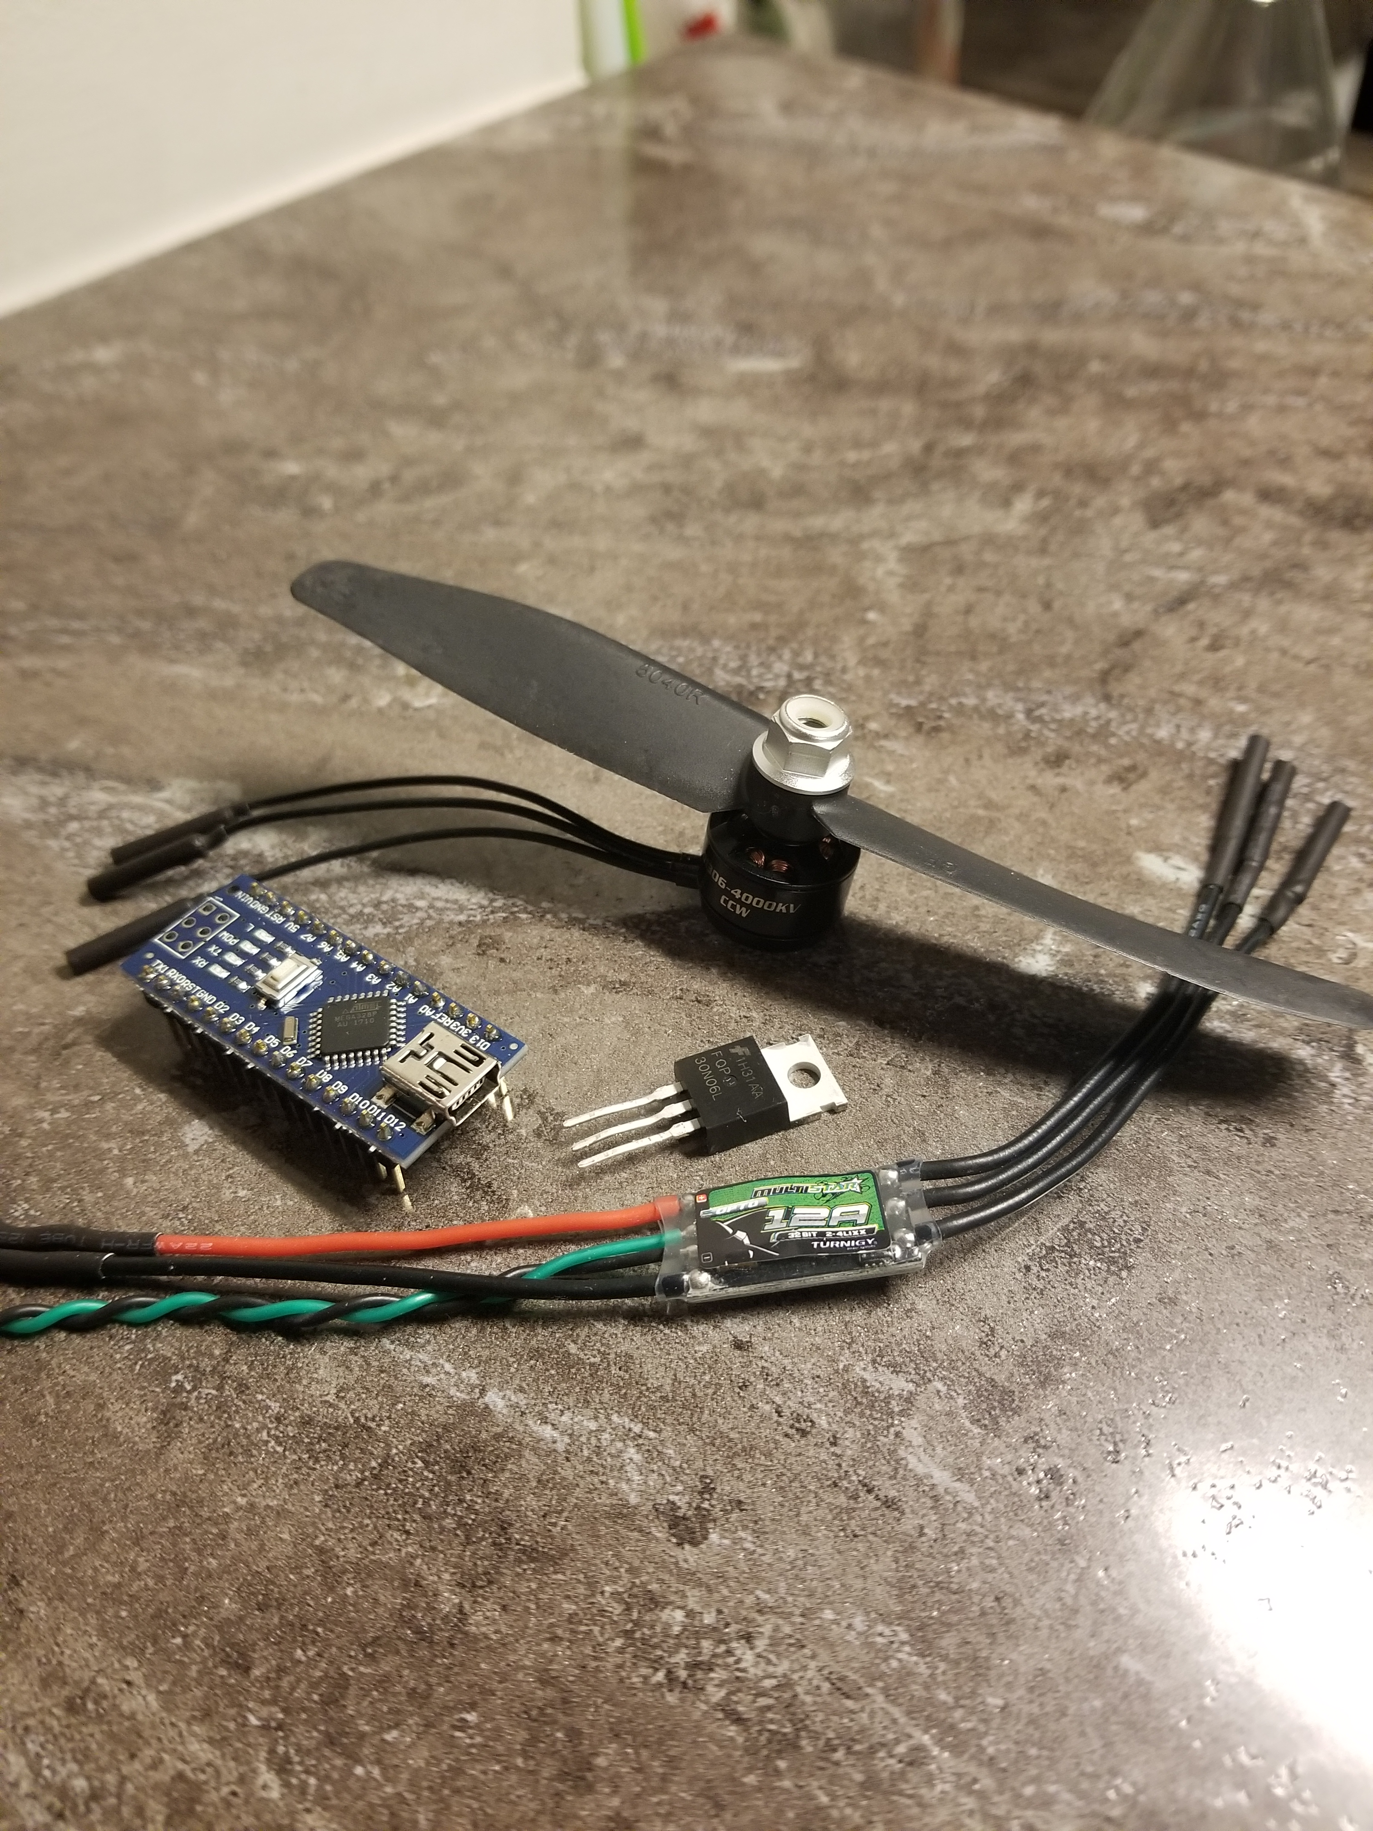
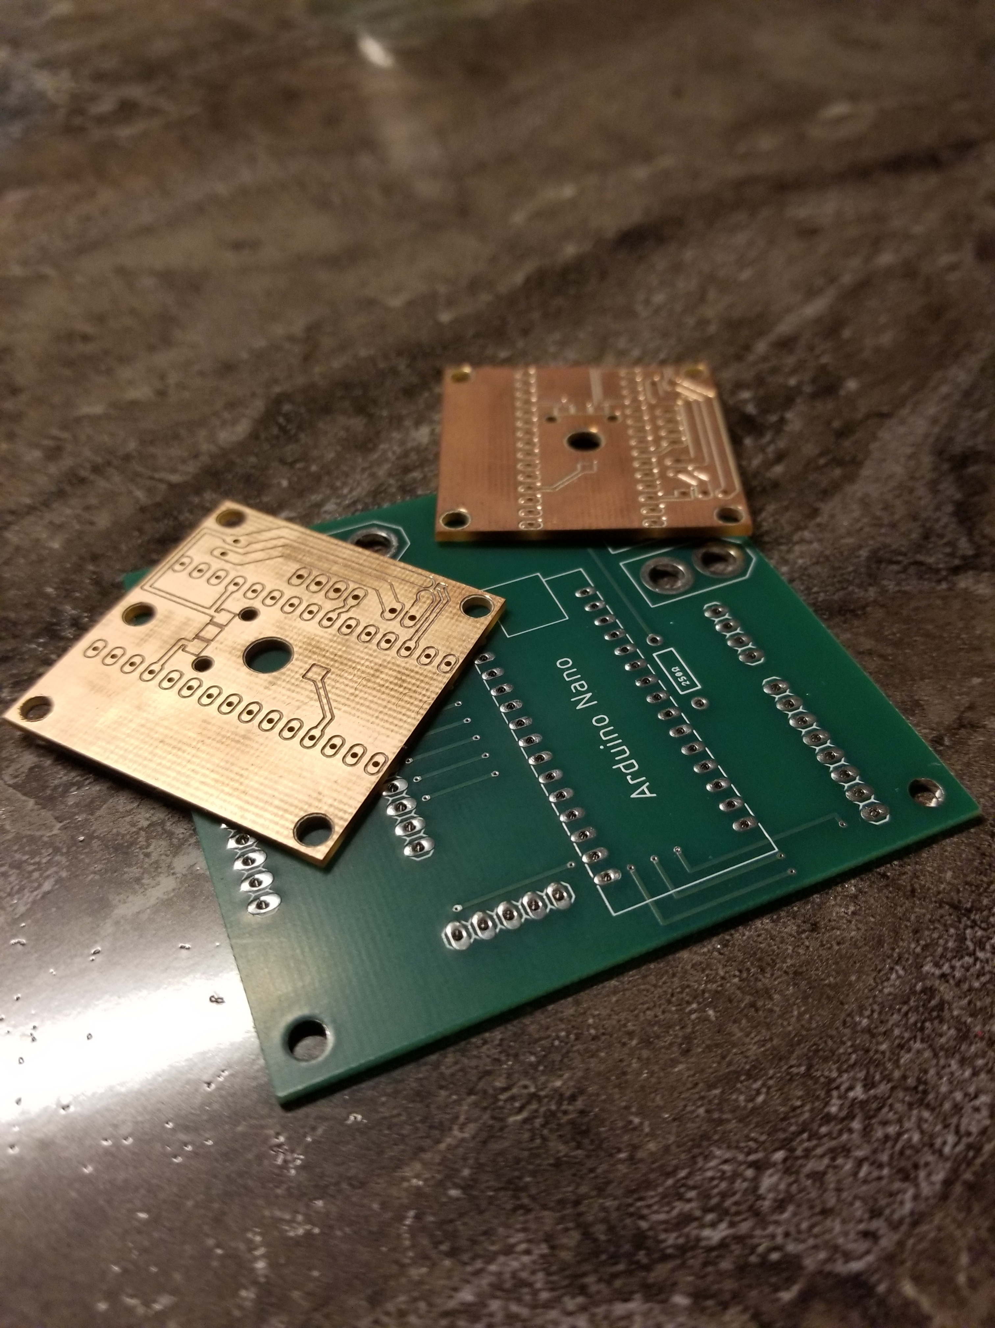
where do I get one?
You make it!
~$50 kit containing
Printed Circuit Board
Electronic Components
Mounting Hardware
Motor & ESC
STL Files
Arduino Code

Slide 8
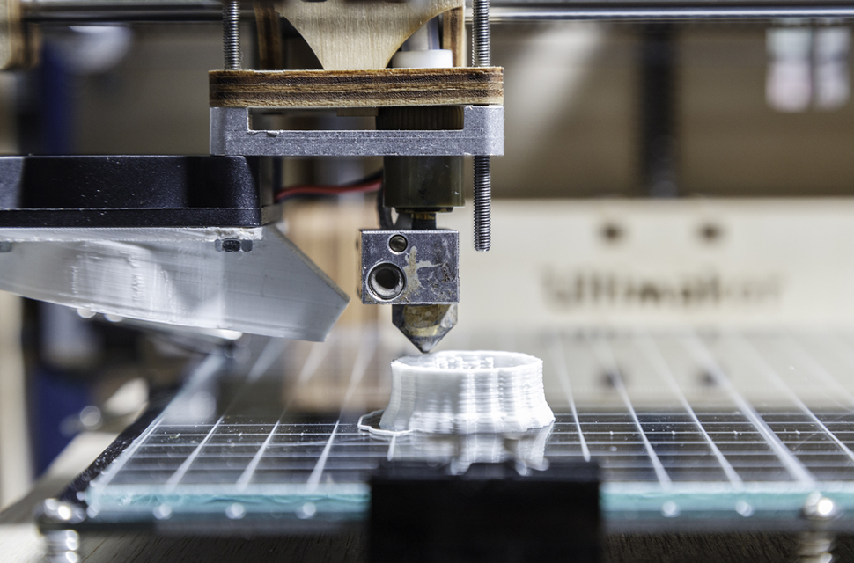


Manufacturing & Assembly
3D Printing
Image Source: https://3dprint.com/166571/3d-printing-misconceptions/
Soldering
Image Source: https://input.club/recommended-soldering-products/
Software
Image Source: https://www.futurelink.com/product/arduino-level-1/
Stay Tuned for User Manual…

Slide 9
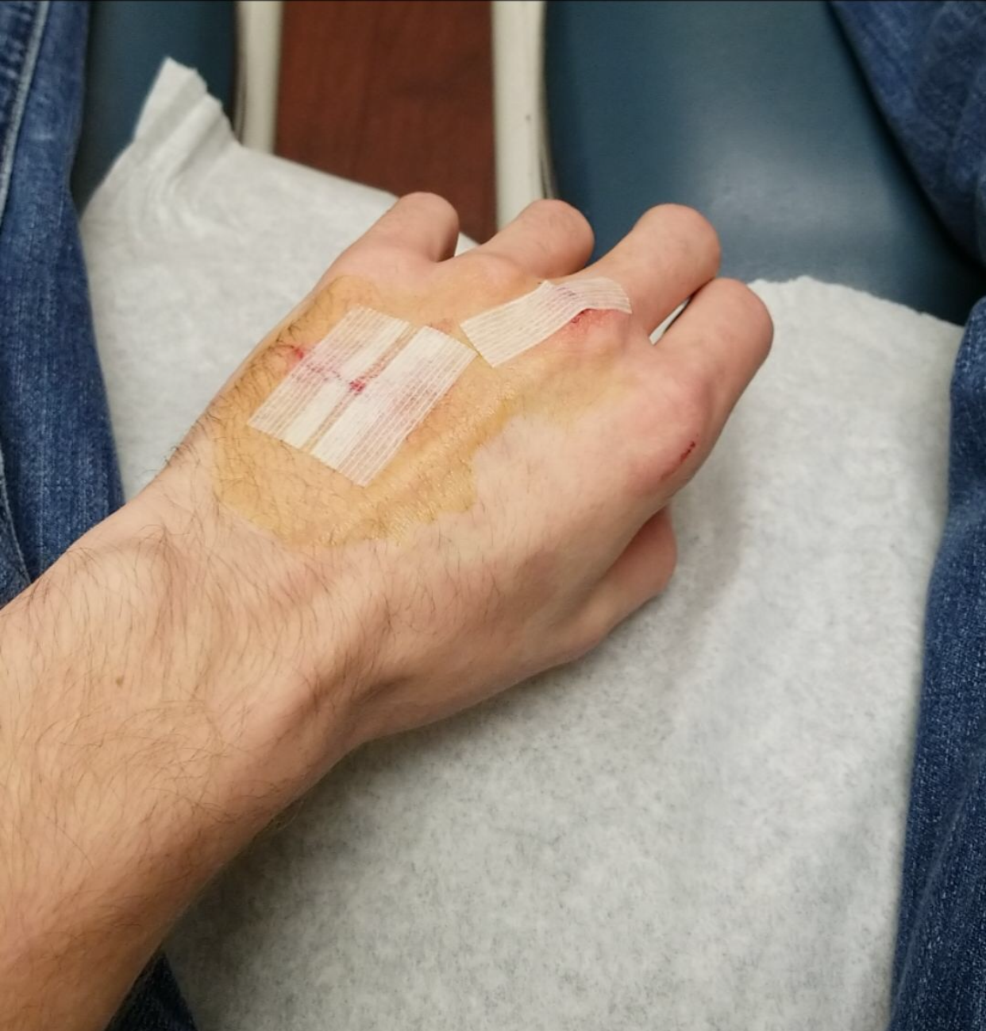

A note on Safetey
These systems may be small, but the motors still run at very high speeds (~20,000 RPM)
This can easily cut your hands or finger
May require a trip to the ER and some stitches
Secure your system to your workbench
Looking into cages
Be Careful!

Slide 10
Let’s See a demo!

Slide 11
Questions?

